Slide 1
Using Machine Learning to Create Heatmaps on Valorant
App Physics 157 TX-1
Lance Clemente

Slide 2
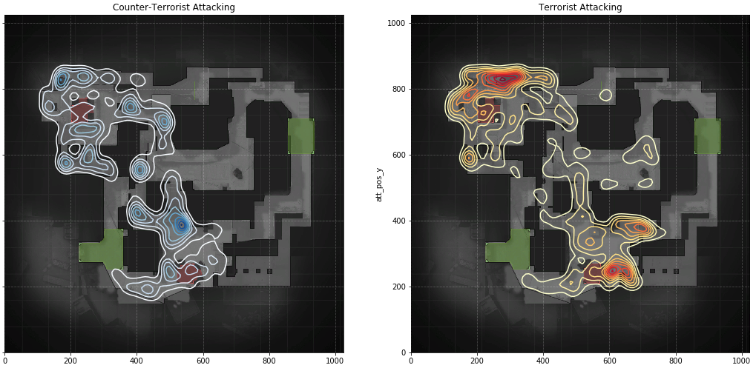
Significance
Heatmaps.
Shows trends, habits, common positions.
Useful for all kinds of players
Ease to access Information
Data required for these Heatmaps are easily accessible in Counter Strike, but not in Valorant (secure).

Slide 3
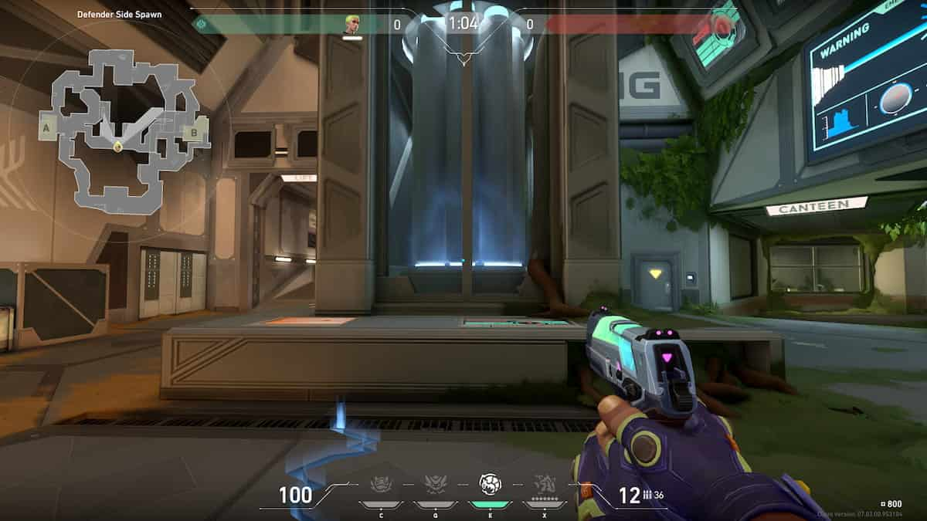
Background
Valorant VODs and Heatmaps
Workaround: VODs, and getting analytics from them instead
Can work with videos, livestreams, still images, all you need is the MINIMAP.

Slide 4
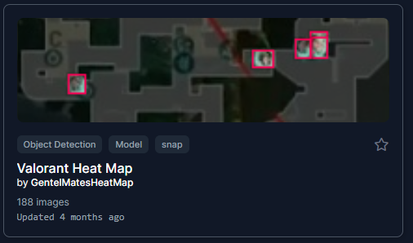
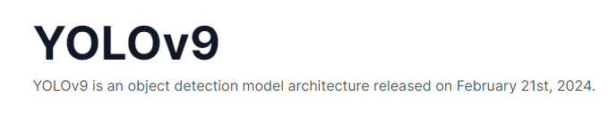
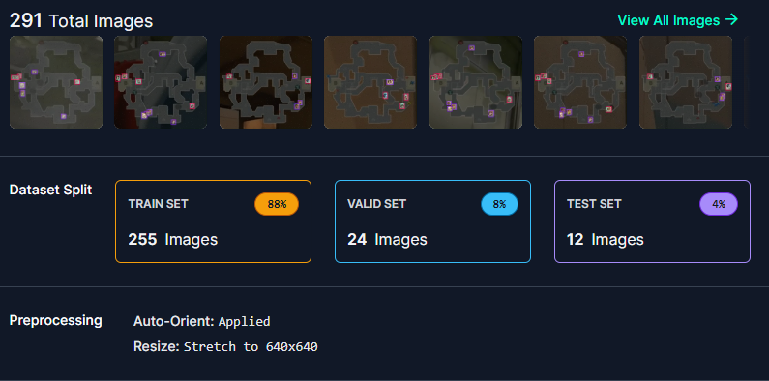
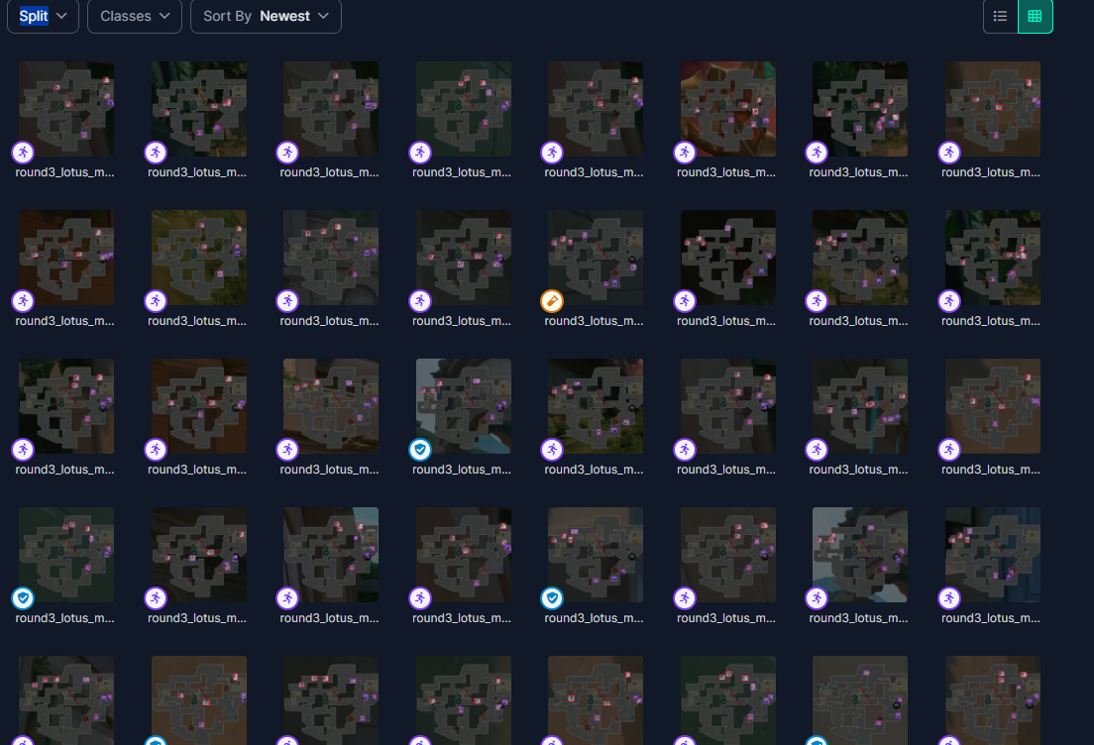
Material: Machine learning for object detection
Dataset from: https://universe.roboflow.com/gentelmatesheatmap/valorant-heat-map/dataset/2

Slide 5
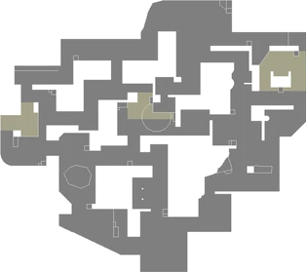
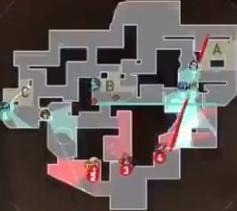
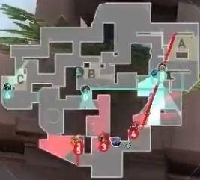
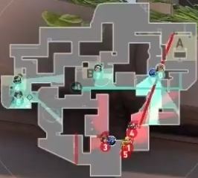
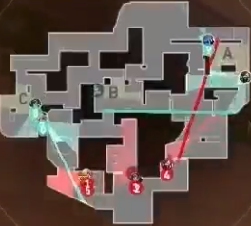
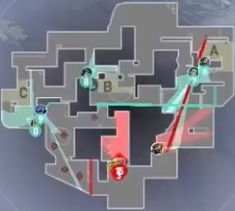
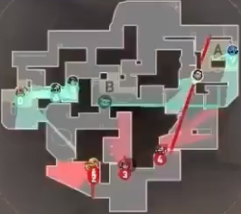
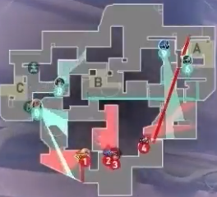
Method: Inputting custom data
Positions of all players at round start: Estudyante Esports, OBE (atk) vs MKL(def), Lotus

Slide 6
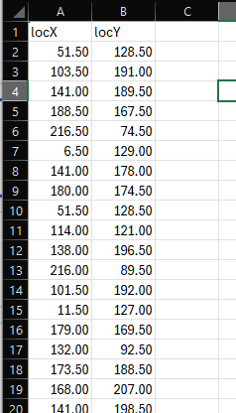
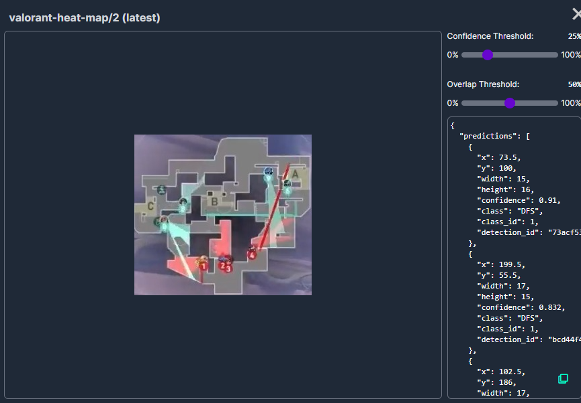
Method: Machine learning for object detection
https://universe.roboflow.com/gentelmatesheatmap/valorant-heat-map

Slide 7
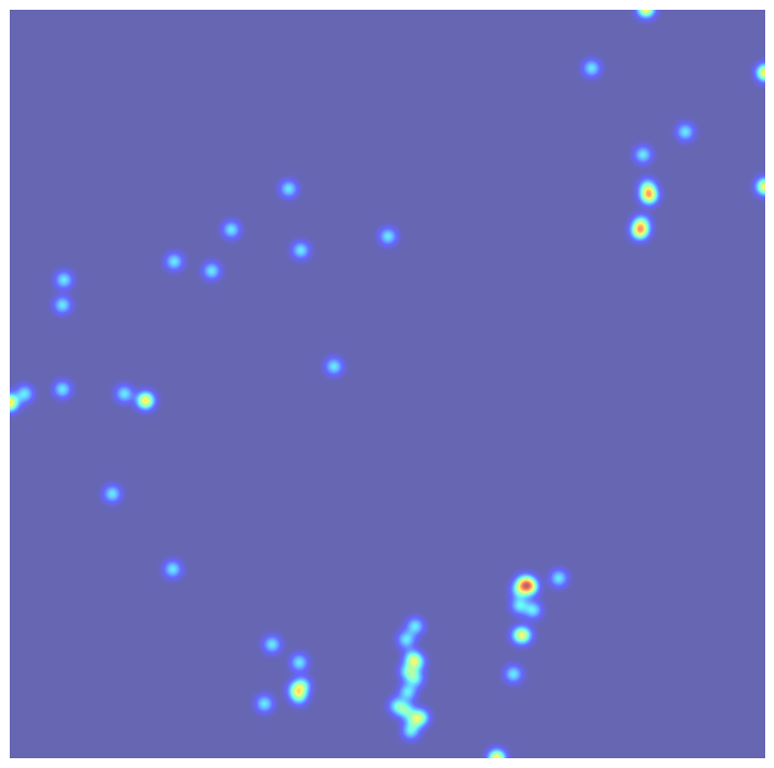
Result
-inaccurate
Comparing it to the actual data,
Some areas highlighted in the heatmap were not utilized in the actual data.
Limitation:
Non-uniform image sizes

Slide 8
Conclusion
-Machine Learning allows for the formation of valorant heatmaps from the source of a minimap. This allows of a wide range of analytics. (ex. Spike plant, optimal positions, Most common and uncommon played spots, etc.)
Recommendations:
-More Accurate Predictions (Bigger Dataset)
-More data not just showing positions at round start, can show during events in round(frags, deaths, etc.), Allows for more data analytics.
-Uniform Minimap Orientation and size

Slide 9
References
https://universe.roboflow.com/gentelmatesheatmap/valorant-heat-map/dataset/2
https://github.com/igoyalsamarth/val-data-stuff/tree/main/Radar%20Heatmap
https://docs.ultralytics.com/models/yolov9/

Slide 10
Using Image Processing to on Mousepad Weaving
App Physics 157 TX-1
Lance Clemente

Slide 11
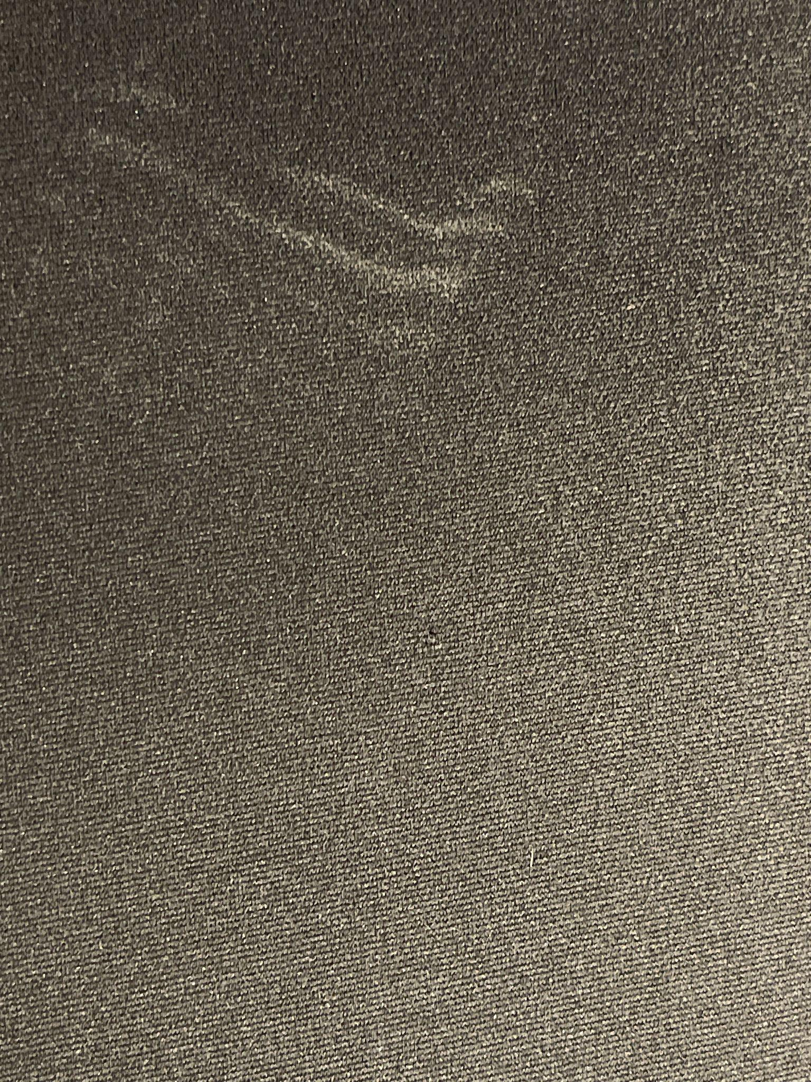
Background
Cloth mousepad
Used and Dirty
Has a woven cloth pattern
Similar to our Module B2 Lab Assignment
Observe the mousepad with the woven pattern filtered out

Slide 12
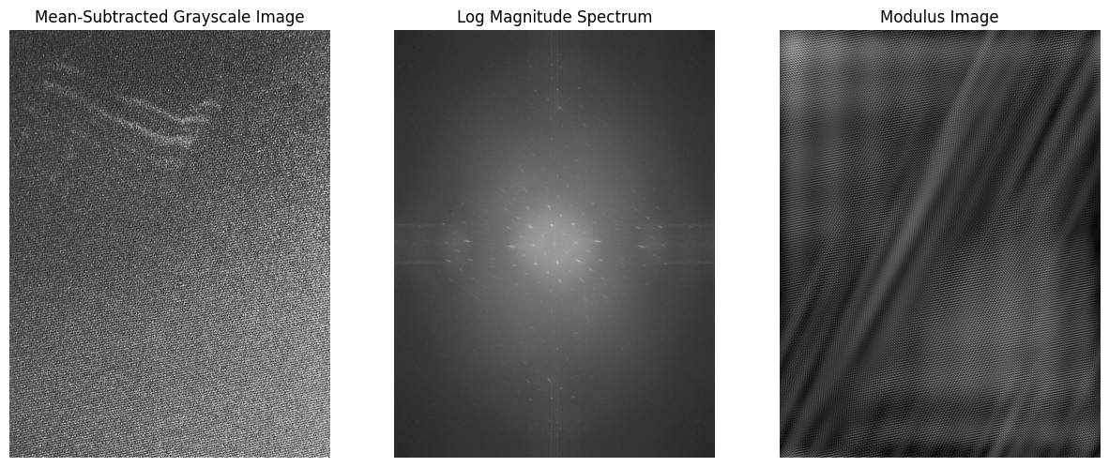
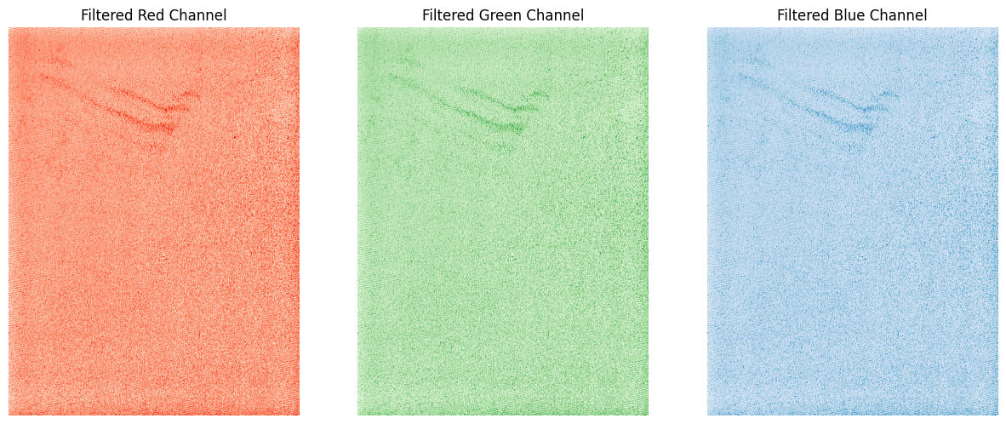
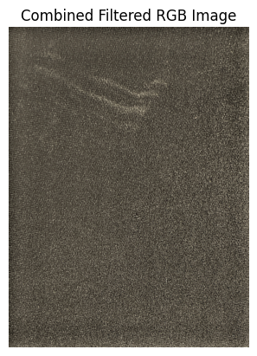
Method: Fourier transform pattern filtering
Greyscale & mean value
FFT
Identifying and Masking symmetric Peaks on FFTed RGB Channels of original image
Inverse FFT and observe The mousepad without the cloth weave.

Slide 13
Results: Pattern filtered out
Light shine on cloth pad was also filtered out.

Slide 14
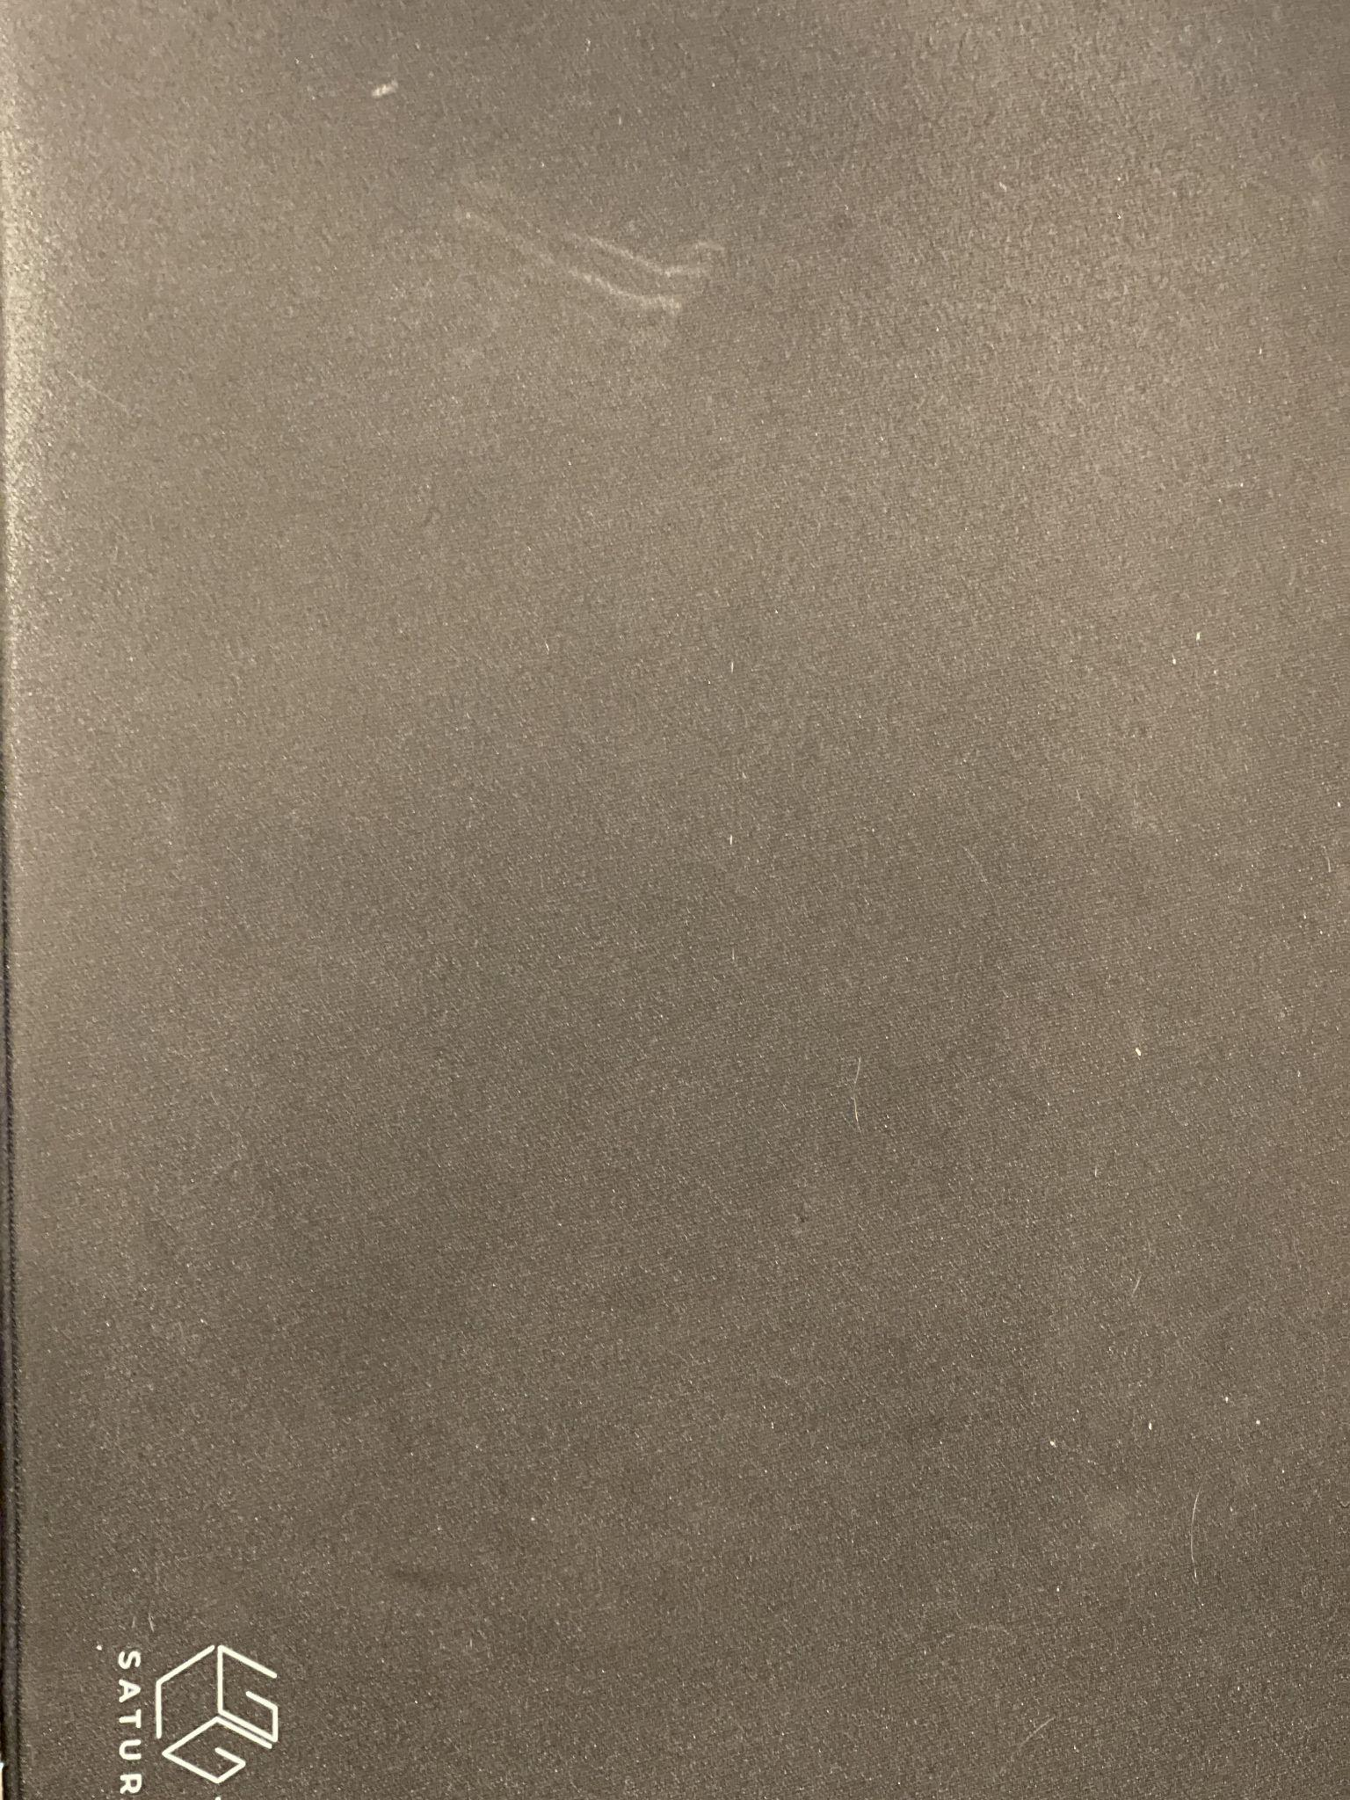
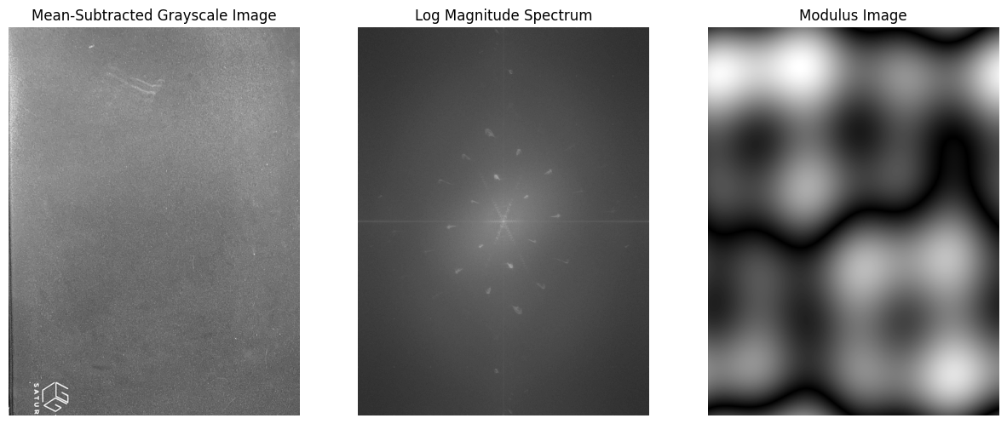
Limitations: Photo taken from afar, cloth pattern cannot be seen.

Slide 15
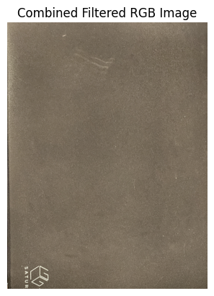
Limitations: Photo taken from afar, cloth pattern cannot be seen.
Original

Slide 16
Recommendations
can be used to see unusual objects on plain cloths

Slide 17
Thank You!

